Slide 1
Audio Programming Project
Real-Time Modal Resonator
Pi Xiaojie and Sean Turland

Slide 2
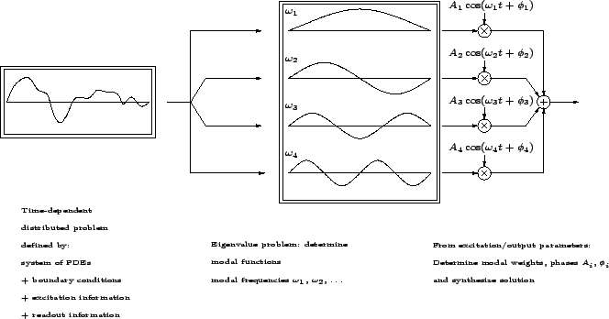
Description
Modal decomposition of the vibration of objects
System takes an Excitation input
PDE description modelled efficiently for real-time audio by narrow bandpass filters at each partial

Slide 3

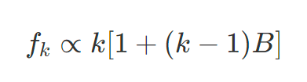
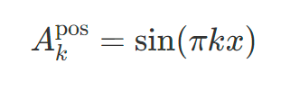

The Maths

Slide 4
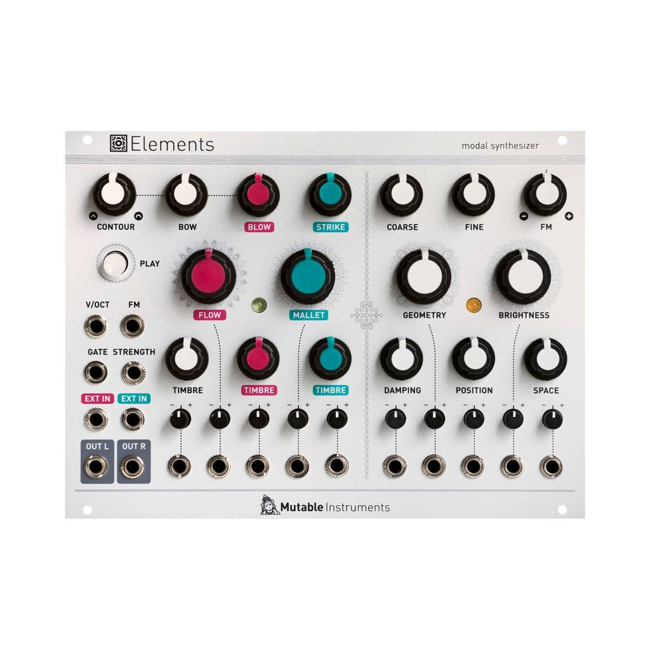
Mutable Instruments
Finely-tuned lookup tables
Interpolates between modal settings of various objects, materials

Slide 5
Parameters
Frequency
Sets the fundamental frequency, f0
Structure
A ‘metaparameter’ which indexes the lookup tables for modal interpolation
Damping
A global damping control of parameter, b0
Brightness
A global brightness attenuation which effects the amplitude of higher partials
Position
An approximation of the excitation position, x.

Slide 6
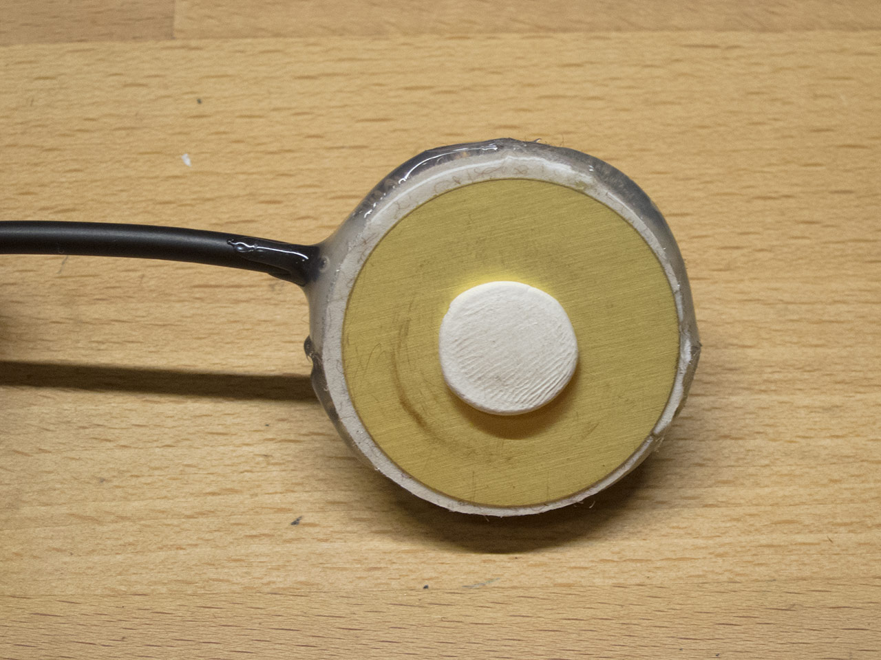
Audio Demo
Excitation: Contact Microphone
Other options:
Field Recordings
Oscillator
Vocals

Slide 7
Future Work
Midi-controllable frequency
Compression/Limiter
Excitation Cross-Modulation with internal oscillator
Randomness

Slide 8
References
Bilbao, Stefan. 2006. “Modal Synthesis.” https://ccrma.stanford.edu/~bilbao/booktop/node14.html
Ren, Zhimin et al. 2012. “Example-Guided Physically Based Modal Synthesis.”
Gillet, Émilie. 2015. Mutable instruments’ “Elements.”
Bank, Balázs et al. 2010. “A Modal-Based Real-Time Piano Synthesizer.” IEEE Trans. on Audio, Speech, and Language Processing.
Ho, Nathan. 2019. “Exploring Modal Synthesis”

